Slide 1
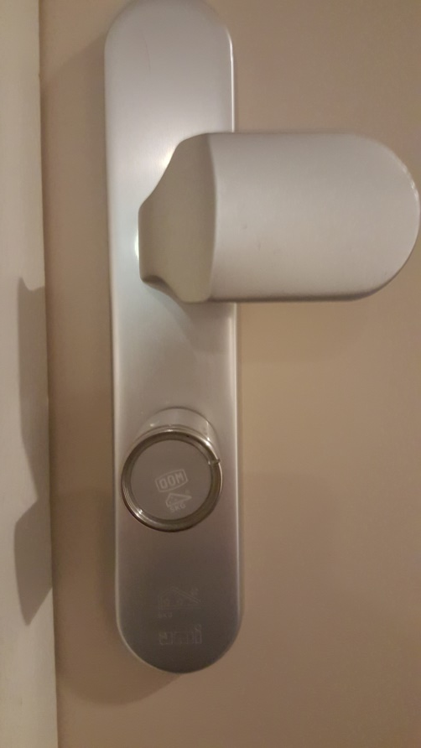
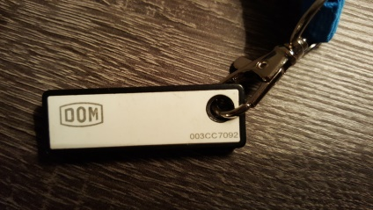
Your electronic door lock: the DOM Protector
Not locked? Be aware that a burglar equipped with a flexible plastic card can open your door in no time!
Your Dom Protector shows first red upon tag identification? Your battery needs to be replaced bij WIEK DE LAAT BEVEILIGING!
Read more? See slide notes.
Notes:
Provided you have locked your door properly with the electronic DOM Protector, it offers maximum security against burglary. A demonstration how you to properly lock your apartment door from outside, you will have been demonstrated by vb&t upon taking over your apartment. In case you still have questions, consult Klankbord Warande
Be aware that if not locked, your door can be opened in no time with a flexible plastic card (comparable with a credit card but more bendable) which is in every toolkit of both locksmiths and burglars.
Once every year the battery in your DOM Protector will be replaced by WIEK DE LAAT BEVEILIGING. You will be notified in advance in writing. In case you are prevented on any of the proposed dates for battery replacement, make in your own interest soonest a new appointment with WIEK DE LAAT BEVEILIGING!
Usually the life time of the battery is at least one year. If your battery shows red upon holding your tag before the cilinder head than that is the first sign your battery is nearing its end of life. Every week the duration of initially showing red before turning green increases, until after ultimately after 3 weeks the battery will be completely dead (but be aware that in case of very frequent use your battery may already be dead after 1 week!) In that case your only option is to call the emergency number of WIEK DE LAAT BEVEILIGING 073 5492773 (note: during office hours you will need to place the call through the vb&t servicedesk) but that is likely to be on your own costs if you have neglected taking earlier actions. Be also aware that the waiting time for arrival of the on call/standby technician to unlock your door may vary from one up to more than two hours.
Never use any lubricant for maintenance of your DOM Protector otherwise seriously risking to damage the inside electrical components. Maintenance is done yearly by Wiek de Laat in combination with battery replacement.
Your tags are programmed not only for your own apartment door but all common accces entrance doors secured with a card reader or DOM Protector.

