Slide 1
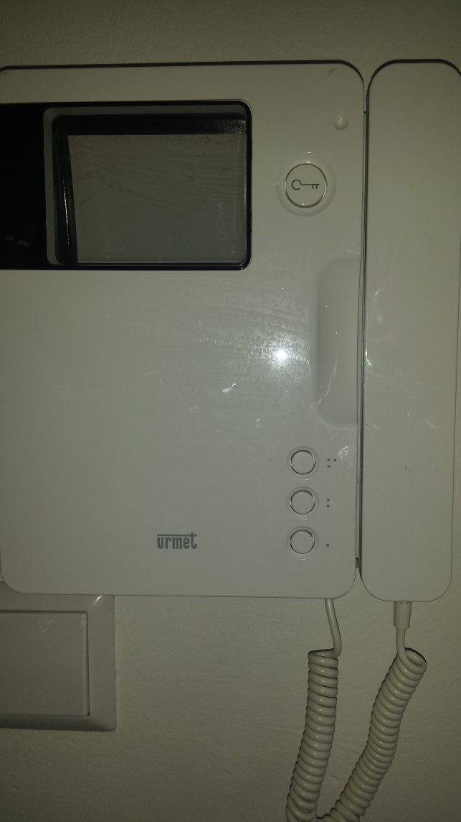
Swapping the setting of your Urmet video door phone between the, for our controlled access security purpose, wrong user mode and the correct user mode
2
Next press with your other hand the door opener button. Hold for a short moment both buttons pressed until you hear two “bleeps”. The two bleeps indicate that you changed the setting of your monitor to the other user mode and you can release now both buttons
1
Press the upper button (marked with three dots) of the three additional service buttons and keep it pressed
After swapping the user mode always verify the correct mode of your video door phone by simply double-checking its proper working on the door entry panel at your main building entrance
Notes:
Be aware that you can not see on your door video phone which user mode has been set. By swapping you only know that you changed to the other mode be it the right one or the wrong mode. Therefore always do the double-check at the door entry panel to ensure your video door phone is in the controlled access mode.

