Slide 1
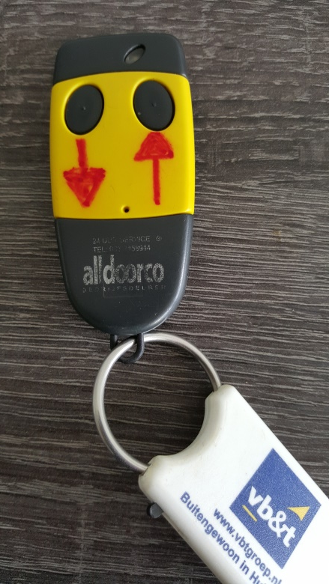
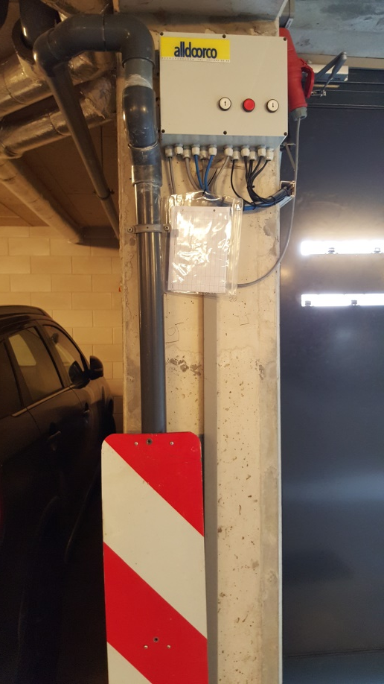
The left button (channel) of your hand transmitter is intended only for use for driving in! Your right button can be activated by Klankbord Warande for use to exit the parking garage. See slide notes for further information.
The automatic closing system may be occasionally unreliable. Check always upon entering or exiting the parking garage. If required close the roller door manually by keeping the right button of the alldoorco system box pressed for up to 30 seconds until the roller door starts moving downward.
Notes:
The day-to-day experience learns that the majority of drivers prefers to use their hand transmitter for exiting the parking garage instead of driving up until above the ground loop in front of the roller door, next wait a couple of seconds after which the roller door automatically opens. Standard only one channel is activated on your hand transmitter; this channel which you operate with the left button on your hand transmitter is meant only for entering the parking garage. The problem is that if you use this left button for exiting the parking garage, you are frustrating the red/green signalling system and you are driving out the parking garage through a red light whilst at the outer side a green light is being shown. To remediate this unsafe situation , the receiver of the Alldoorco control system has been made suitable for a second channel in order to distinguish between cars driving in and cars driving out of the parking garage. Your hand transmitter is already two channel capable, only the second channel has to be activated. Once programmed to work in combination with the two channel receiver the function of the left button (channel A) of your hand transmitter will continue to serve for entering the parking garage. However, the right button (channel B) should be used solely to exit the parking garage. Of in total 43 hand transmitters 28 hand transmitters have already been configured by Klankbord Warande for two channel operation. The configuration needs done to be in combination with the receiver next to the roller door and takes not more including testing than 2 minutes. If the right button of your hand transmitter has not yet been activated, contact Klankbord Warande!
All drivers are kindly requested, regardless whether they have a green light, to always drive carefully inside the parking garage and leave enough space to an opposing driver in particularly to a car entering the garage.

