Slide 1
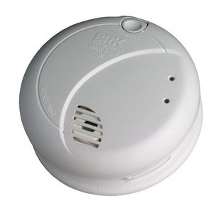
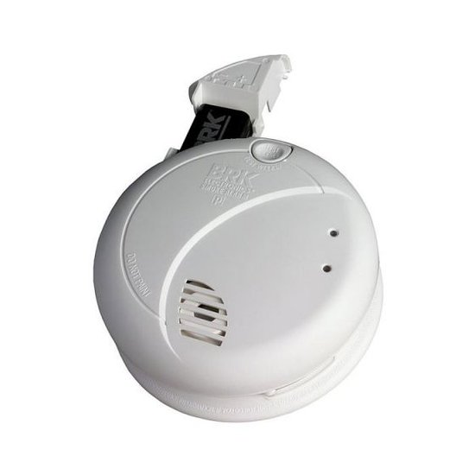
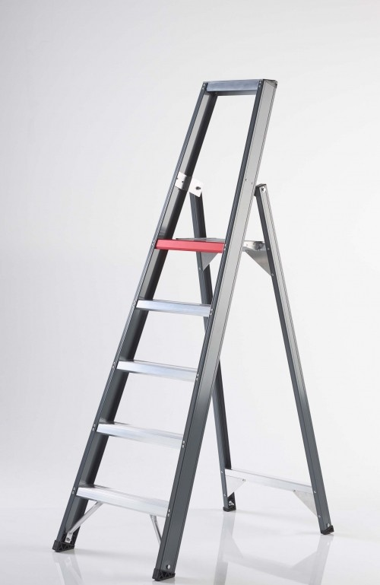
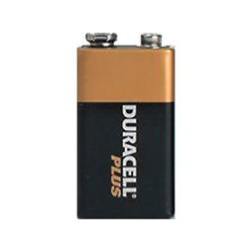
To replace battery there is no need to disconnect the smoke alarm from its mounting bracket at the ceiling
BRK Smoke Alarm 7010BE
Turn off the 230V mains power !
Open the slide-out battery drawer
Remove the battery
Press and hold the test button to discharge
Insert a new battery – same type, 9V alkaline battery
Lock the battery compartment
Test the battery back-up
Restore the mains power
Use a ‘fresh’ battery
Use a solid step ladder
https://www.youtube.com/watch?v=z6oOz1AYk7Y instruction to replace battery – step 2 thru7
JdV Klankbord Warande , version 1.0, September 2015
Notes:
When the battery back-up becomes weak, the Smoke Alarm will “chirp” about once a minute (the low battery warning). This warning should last 30 days, but you should replace the battery immediately to continue your protection.
Internet research learns that a typical life cycle for the back-up battery in the de BRK Smoke Alarm 7010BE as used in a environment and configuration like the Warande building, generally does not exceed 3-4 years. To prevent low battery warning during night hours or other periods when not prepared for replacing it, the recommendation of your residents’ committe is to replace it at least every 3 years.
Make sure you use a fresh alkaline battery for replacement preferably still 5 years away from its expiration date and hasn’t been sitting on the shelf for a couple of years.
Always discharge the branch circuit before servicing a mains (AC) or AC/DC Smoke Alarm or to replace a battery. First, turn off the mains (AC) power at the fuse box. Next, remove the battery from the Smoke Alarm. Finally, press and hold the Test/Silence button for 5-10 seconds to
discharge the branch circuit.

